Slide 1


Robert J (John) Anderson
20 February 2022

Slide 2

Outline
Executive Summary
Introduction
Methodology
Results
Conclusion
Appendix

Slide 3
Executive Summary
In this project, we wanted to determine if we can predict whether the Falcon 9 first stage will land successfully. SpaceX advertises Falcon 9 rocket launches on its website with a cost of $62M; other providers cost up to $165M each; much of the savings because SpaceX can reuse the first stage.
If we can determine whether the first stage will land, we can determine the cost of a launch. This information can be used if an alternate company wants to bid against SpaceX for a rocket launch.
Use of Exploratory Data Analysis and Interactive Visual Analytics resulted in the identification of variables for the classification features data set – such as Launch Site, Payload Mass, Orbit, Booster Version, and Landing Pad
Among the four studied classification models, Decision Tree distinguished best between the different classes, with 83.3% prediction accuracy for ‘landed’ results and ‘did not land’ results
Given the presented SpaceX launch data from 2010-2020, yes, using EDA and Predictive Analysis, we can predict whether the Falcon 9 first stage will land successfully

Slide 4
Introduction
In this project, we want to determine if we can predict whether the Falcon 9 first stage will land successfully. SpaceX advertises Falcon 9 rocket launches on its website with a cost of $62M; other providers cost up to $165M; much of the savings because SpaceX can reuse the first stage.
If we can determine whether the first stage will land, we can determine the cost of a launch. This information can be used if an alternate company wants to bid against SpaceX for a rocket launch.
We will obtain launch data from SpaceX and open-source web sites, apply Exploratory Data Analysis and Interactive Visual Analytic methods to develop and refine Feature Sets and Launch Outcome Label Sets, and then predict launch outcomes using Predictive Analysis algorithms.

Slide 5

Section 1

Slide 6
Methodology
Data collection methodology: applied SpaceX REST API, targeting several endpoints to obtain Falcon 9 launch data; used BeautifulSoup to access HTML tables and obtain additional launch data
Perform data wrangling: processed missing values, performed breakdown of launches by orbit, reviewed different booster landing outcomes to create a landing outcome training label (Y = 0 or 1)
Perform exploratory data analysis (EDA) using visualization and SQL: identified features that affected landing outcome (e.g., launch site, payload) to include feature interactions
Perform interactive visual analytics using Folium and Plotly Dash: used Folium to examine launch site proximities to help identify optimum location; used Dash to interactively examine launch site, booster version category, and payload relationships
Perform predictive analysis using classification models: preprocessed data (e.g., standardized data and split into train and test subsets), used grid search method to find best hyperparameters with four classification algorithms, selected best algorithm prediction accuracy using confusion matrix

Slide 7
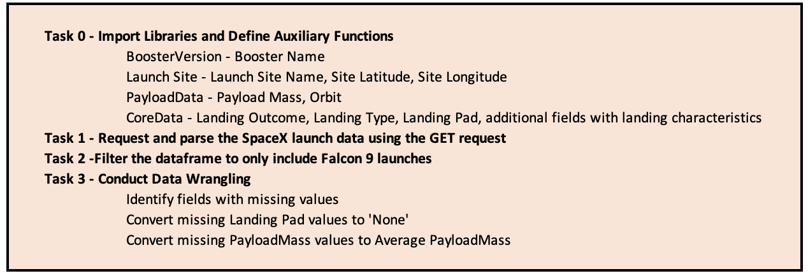
Data Collection – SpaceX API
Flowchart of SpaceX API calls
https://github.com/rjohna/IBM-Capstone-for-DS/blob/master/Data%20Collection%20API.ipynb

Slide 8
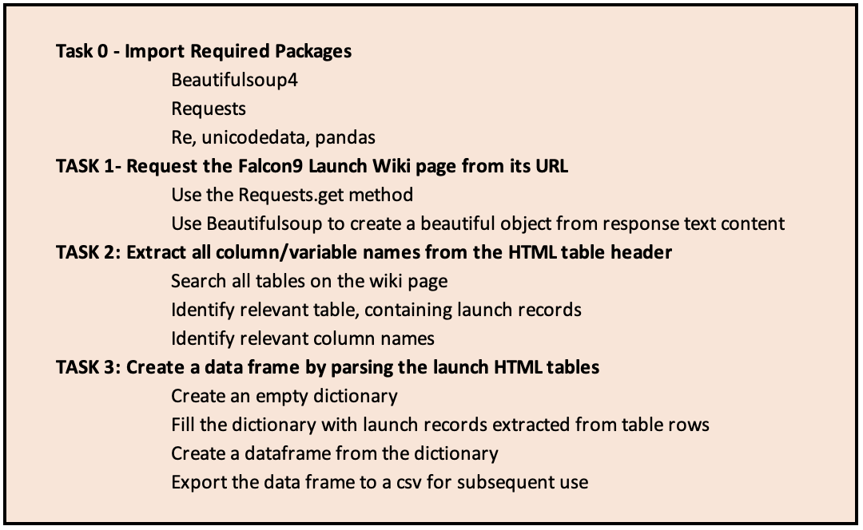
Data Collection - Scraping
Flowchart of SpaceX Web Scraping Tasks
https://github.com/rjohna/IBM-Capstone-for-DS/blob/master/Data%20Collection%20-%20Web%20Scraping.ipynb

Slide 9
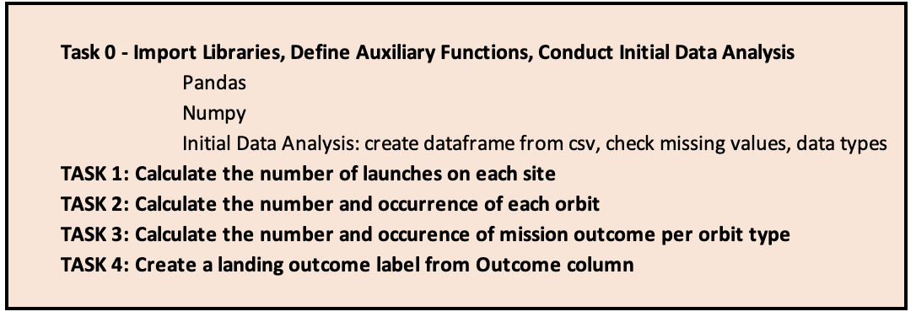
Data Wrangling
Flowchart of Data Wrangling Tasks
https://github.com/rjohna/IBM-Capstone-for-DS/blob/5848ce40a1c508da620c4bf93e45b1ccc85dfc38/EDA.ipynb

Slide 10
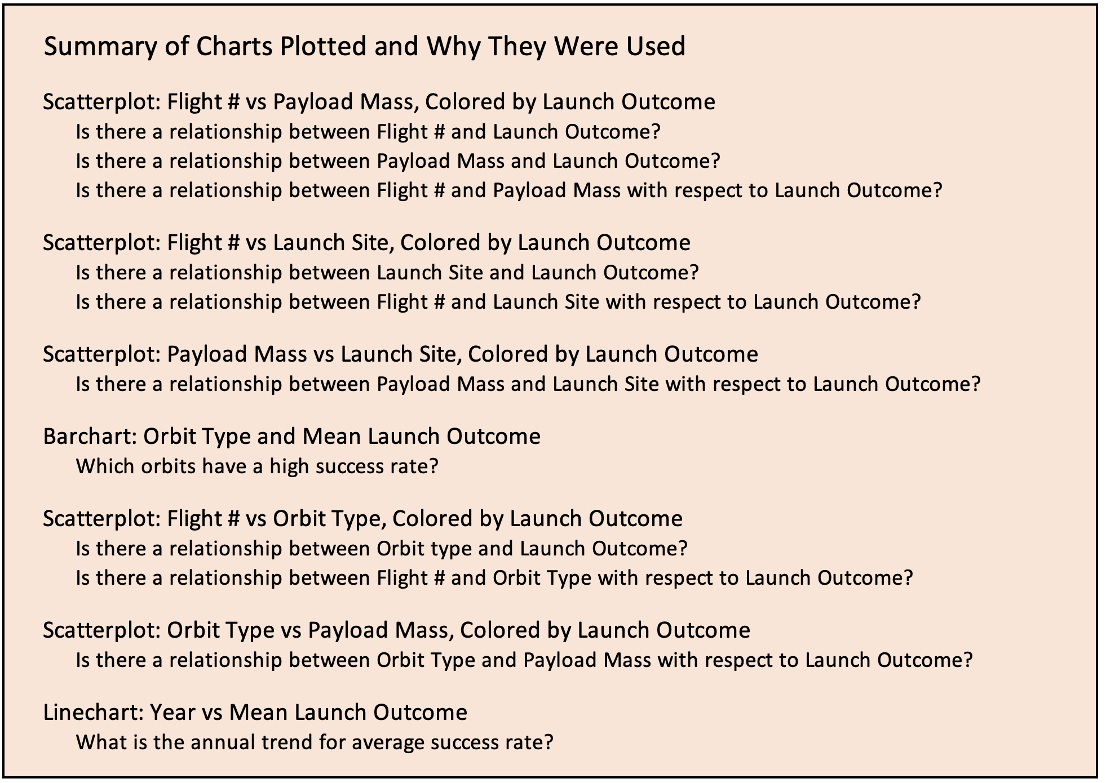
EDA with Data Visualization
https://github.com/rjohna/IBM-Capstone-for-DS/blob/master/EDA%20with%20Visualization.ipynb

Slide 11
EDA with SQL
For SQL EDA we performed the following queries
All launch site names
Cape Canaveral launch sites
Total payload mass for NASA customers
Average payload mass for Booster Version F9 v1.1
First successful ground landing date
Successful drone ship landing with payload between 4000 and 6000 Kg
Total number of successful and failure mission outcomes
Boosters that carried the maximum payload
2015 launch records
Rank landing outcomes between 2010-06-04 and 2017-03-20
Note: in spite of dialogue with Coursera and IBM I was unable to resolve recent Service Credential issues with IBM DB2 (credentials worked for me previously). So, rather than accessing DB2 remotely, I performed these queries by directly accessing DB2. The referenced Jupyter notebook reflects that situation.
https://github.com/rjohna/IBM-Capstone-for-DS/blob/master/EDA%20with%20SQL%20Lite.ipynb

Slide 12
Build an Interactive Map with Folium
We wanted to show maps with circles and labels to identify the launch sites, markers to show launch outcomes, and lines to show proximity to local features such as highways
https://github.com/rjohna/IBM-Capstone-for-DS/blob/master/Visual%20Analytics%20with%20Folium.ipynb

Slide 13
Build a Dashboard with Plotly Dash
Note: another technical difficulty; in spite of dialogue with Coursera I am unable to access the IBM Skills Network Lab and my Plotly Dash project. I routinely use SN Labs and had completed the Dash project a few weeks back. I was able to successfully launch the dashboard, but there was some inconsistency and instability in the launching. So, I wanted to review my code one more time before submitting the Final Report and held off on submitting to GitHub. So, now I do not have a GitHub link for this section.

Slide 14
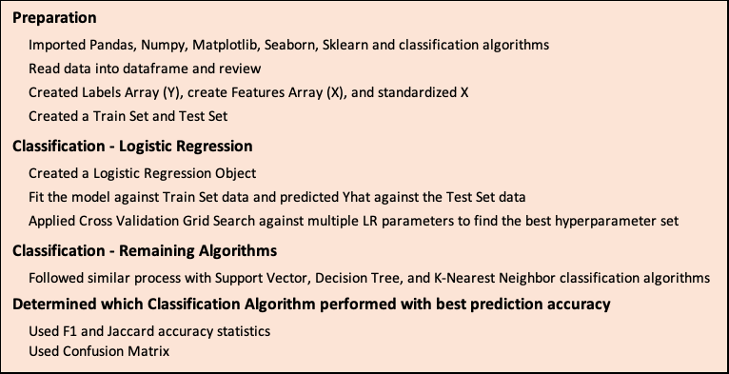
Predictive Analysis (Classification)
https://github.com/rjohna/IBM-Capstone-for-DS/blob/master/Machine%20Learning%20Prediction.ipynb

Slide 15

Section 2

Slide 16
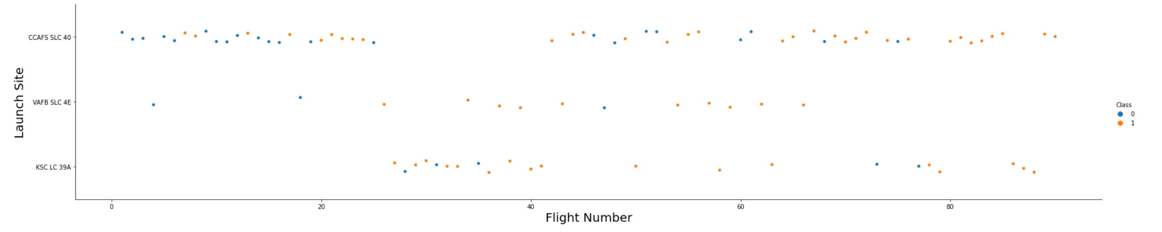
Flight Number vs. Launch Site
Cape Canaveral Space Launch Complex 40 had a tight group of launches toward the beginning of the test period with 9 of 23 launches successful (39%); a second tight group toward the end of the test period showed improvement with of 24 of 32 launches successful (75%)
Vandenberg Space Launch Complex 4 had a lower number of launches generally spread from the beginning thru middle portions of the test period; 10 of 13 launches were successful (77%)
Kennedy Space Center Launch Complex 39 had 22 launches roughly in the last two thirds of the test period with 17 successful (77%)
So, success rates generally appear to improve over time with the later group of Cape Canaveral launches, Vandenberg launches, and Kennedy Space Center Launches having a similar success rate (75-77%)

Slide 17
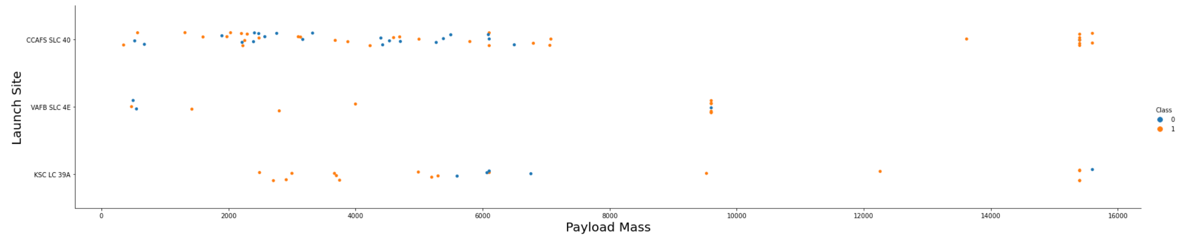
Payload vs. Launch Site
Cape Canaveral Space Launch Complex 40 had most launches with Payload Mass less than 8,000 Kg with roughly half of these successful; there were 5 launches with Payload Mass greater than 13,000 Kg and all of these were successful
Vandenberg Space Launch Complex 4 did not have any launches with Payload Mass greater than 10,000 Kg
Kennedy Space Center Launch Complex 39 had launches with Payload Mass between 2,000 and 16,000 Kg with no particular trend with Payload Mass

Slide 18
Success Rate vs. Orbit Type
Use of orbits with the highest success rate include Sun-synchronous Orbit (SSO), Highly Elliptical Orbit (HEO), Circular Geosynchronous Orbit (GEO), and Sun Earth Lagrange Point (ES-L1), all at 100%
Use of the Very Low Earth Orbit (VLEO) was also relatively highly successful at 86%

Slide 19
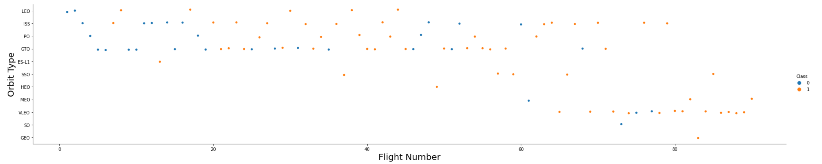
Flight Number vs. Orbit Type
LEO, ISS, PO, and GTO orbits generally were used across the test period
The use of remaining orbits generally occurred towards the end of the test period
In the LEO orbit the Success appears related to the number of flights; on the other hand, there seems to be no relationship between flight number and other orbits

Slide 20
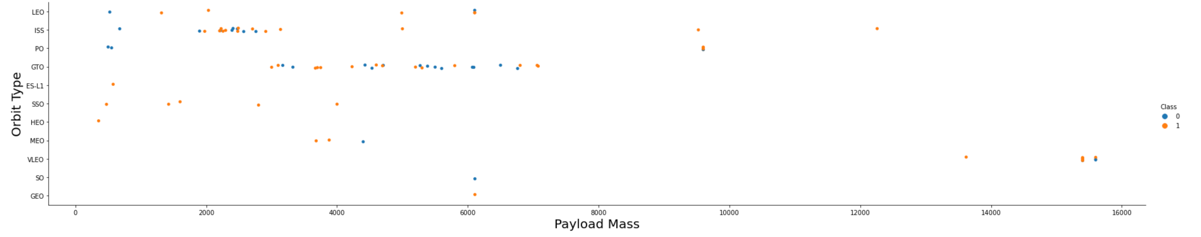
Payload vs. Orbit Type
With heavier Payload Mass the successful landings favor International Space Station (ISS), Polar (PO), and Very Low Earth Orbit (VLEO)
We do not see a relationship between Orbits and successful launches for the lower Payload Mass

Slide 21
Launch Success Yearly Trend
Average launch success rates have generally improved across the test years

Slide 22
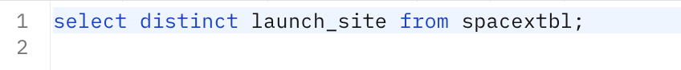
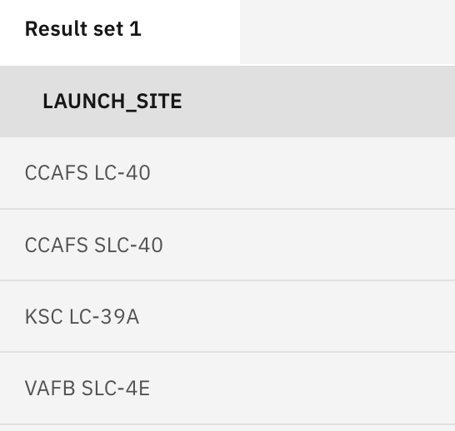
All Launch Site Names
There are four distinct Launch Sites addressed in this study

Slide 23
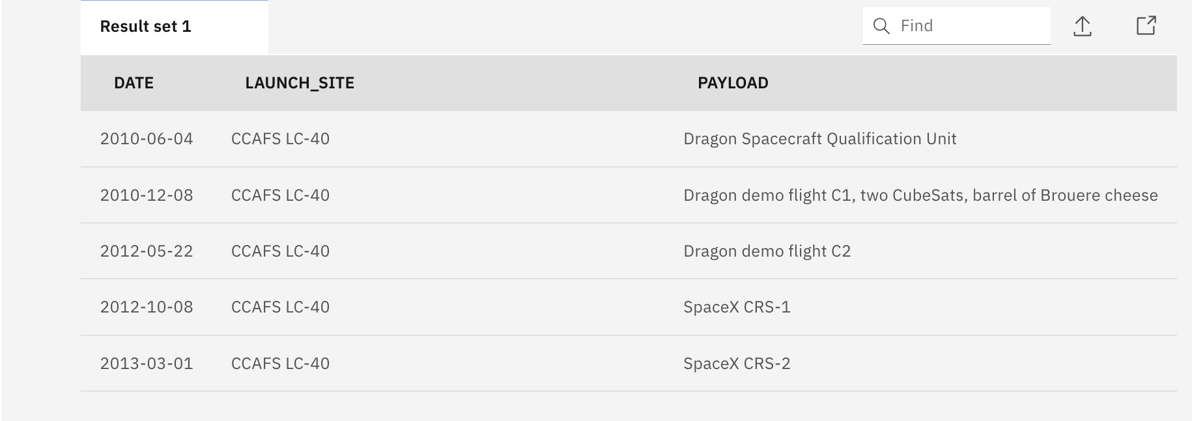
Launch Site Names Begin with 'CCA'
SQL shows 5 Cape Canaveral Launch Site records, where Launch Site Names begin with CCA

Slide 24
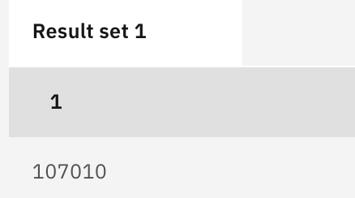
Total Payload Mass
SQL code to calculate to total payload mass where the customer field contained NASA

Slide 25
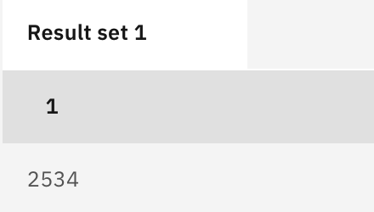
Average Payload Mass by F9 v1.1
SQL code to calculate average payload mass for booster version F9 v1.1

Slide 26
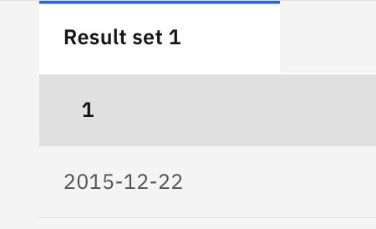
First Successful Ground Landing Date
SQL code finds the first or minimum date for successful landing outcomes on ground pads

Slide 27
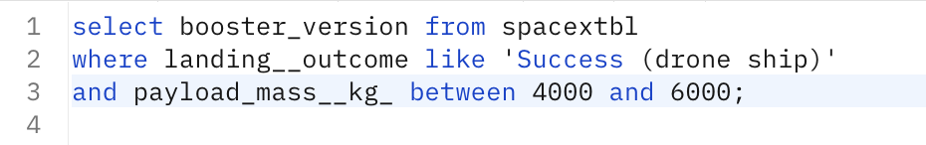
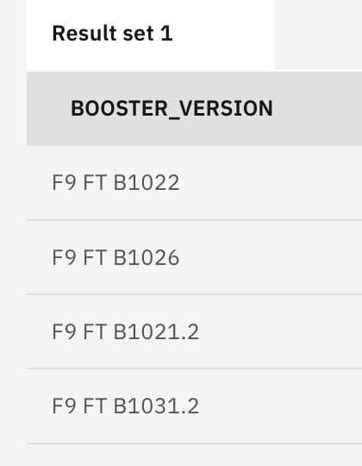
Successful Drone Ship Landing with Payload between 4000 and 6000
SQL list the booster version which successfully landed on a drone ship and had payload mass greater than 4000 but less than 6000

Slide 28
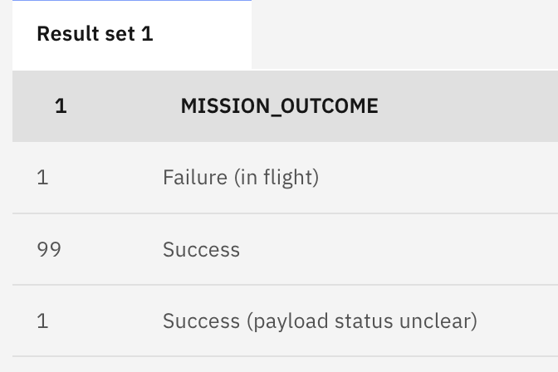
Total Number of Successful and Failure Mission Outcomes
SQL code determines total number of successful and failure mission outcomes; would infer 100 successes

Slide 29
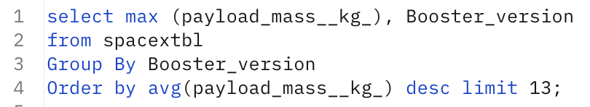
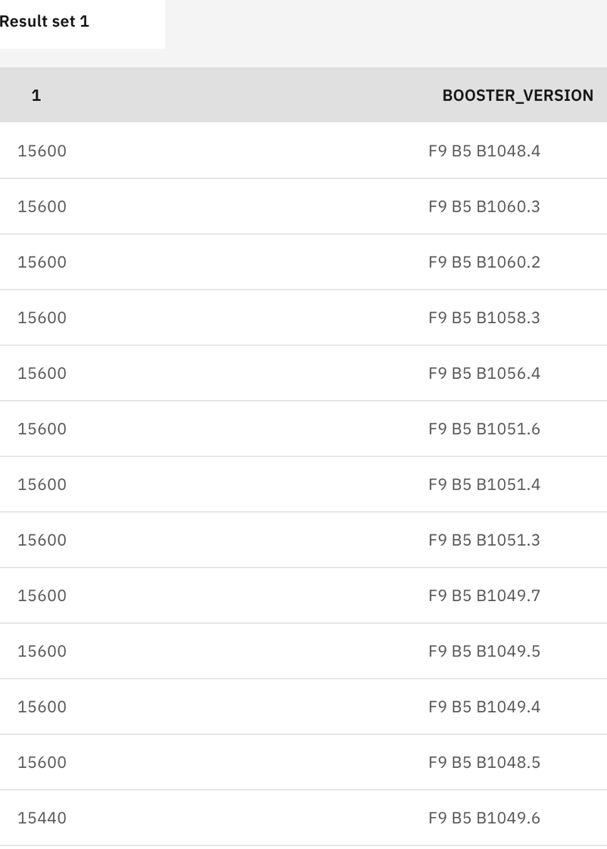
Boosters Carried Maximum Payload
SQL code lists max payload for boosters; there are twelve boosters that have carried the max payload of 15,600 kg

Slide 30
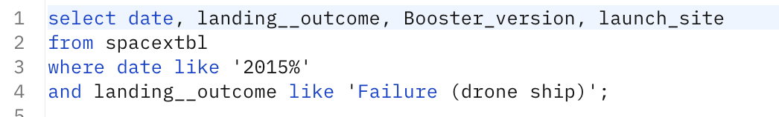
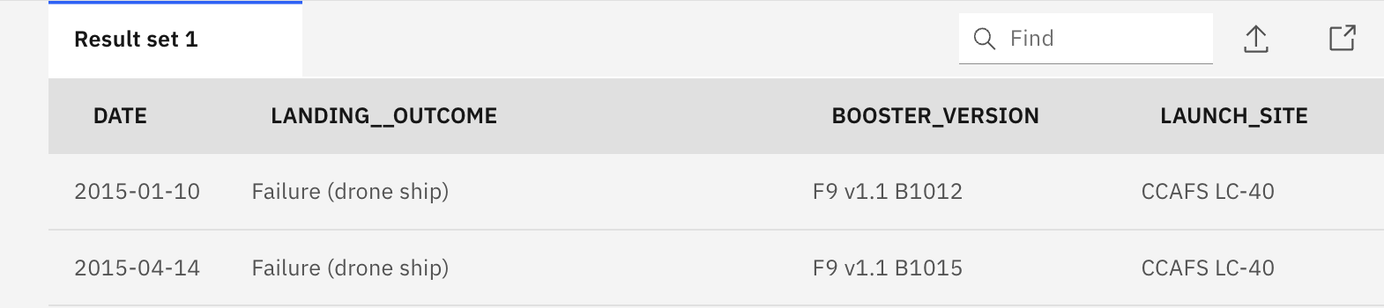
2015 Launch Records
SQL code lists failed landing_outcomes in drone ship, their booster versions, and launch site names in year 2015

Slide 31
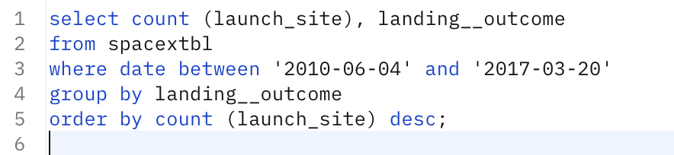
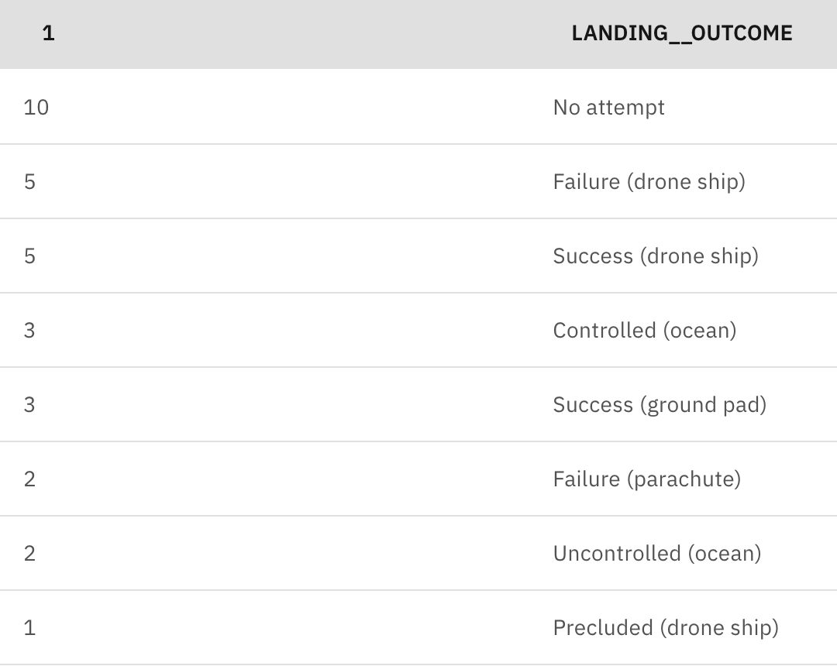
Rank Landing Outcomes Between 2010-06-04 and 2017-03-20
SQL code ranks count of landing outcomes between the date 2010-06-04 and 2017-03-20, in descending order

Slide 32

Section 3

Slide 33
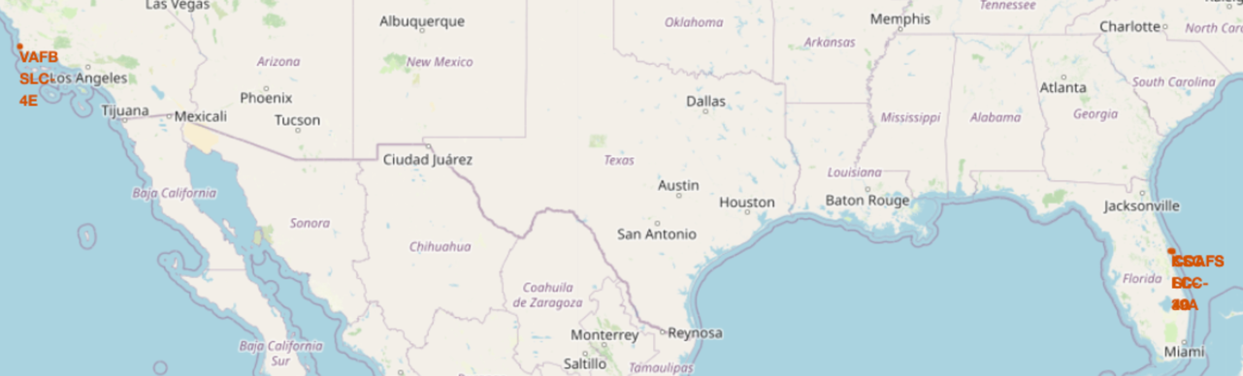
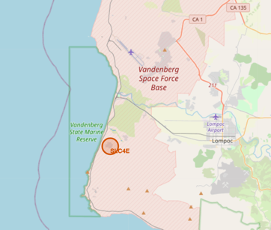
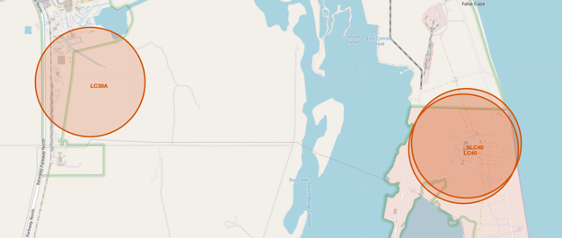
Maps show
In California
Vandenberg Space Launch Complex 4E
In Florida
Kennedy Space Center Launch Complex 39A
Cape Canaveral Launch Center 40 and Space Launch Center 40
All Launch Sites

Slide 34
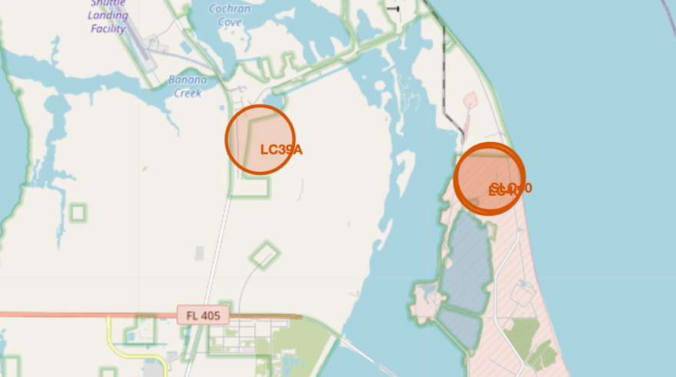
Launch Outcomes
A properly rendered map would show:
For KSC LC-39A - Three successes (green)
For CCAFS SLC-40 – Three successes (green) and four fails (red)

Slide 35
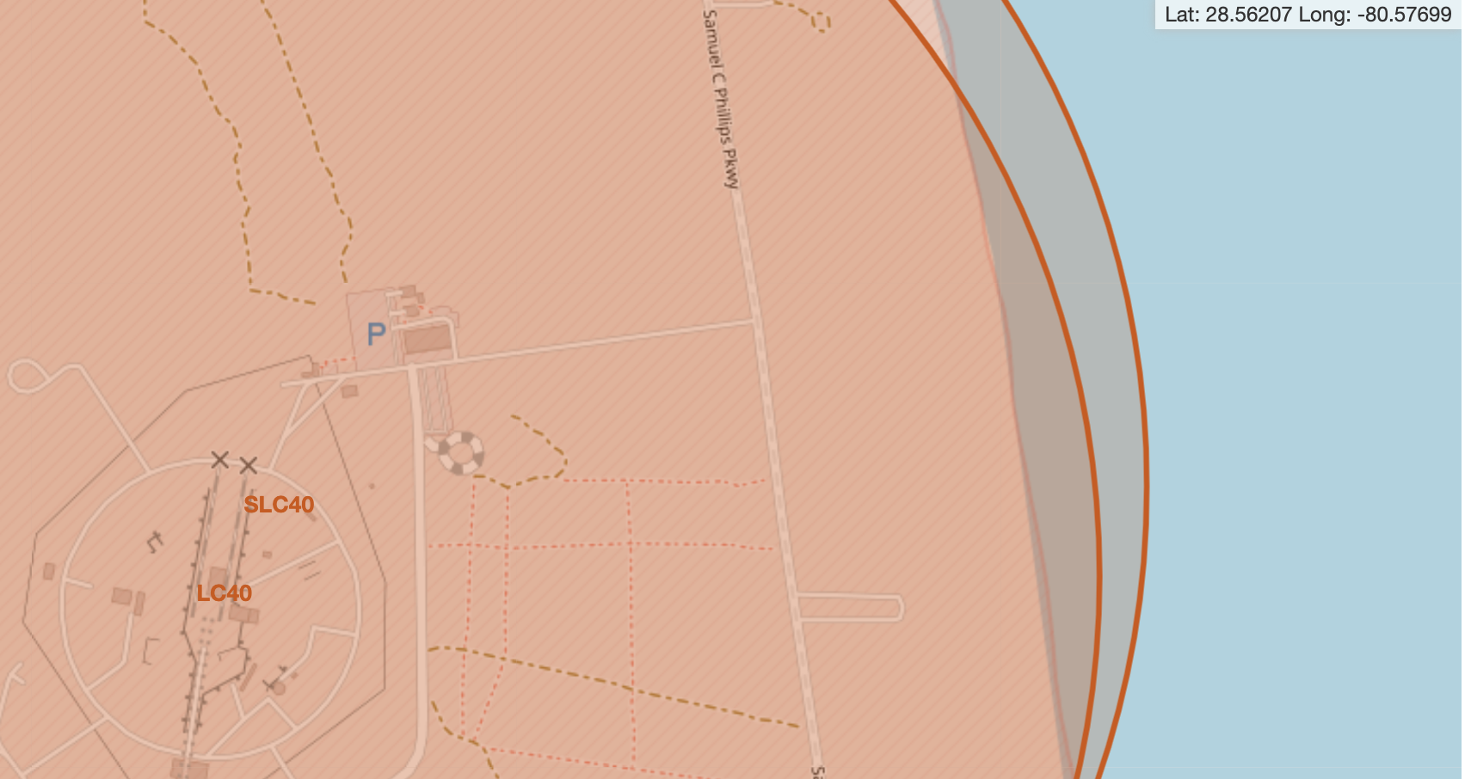
Launch Site Proximities
Straight Line Distance between Cape Canaveral Space Launch Complex 40 and Samuel C Phillips Pkwy is less than 1 KM
This must obviously be included in pre-launch safety considerations
.647 KM

Slide 36

Section 4

Slide 37
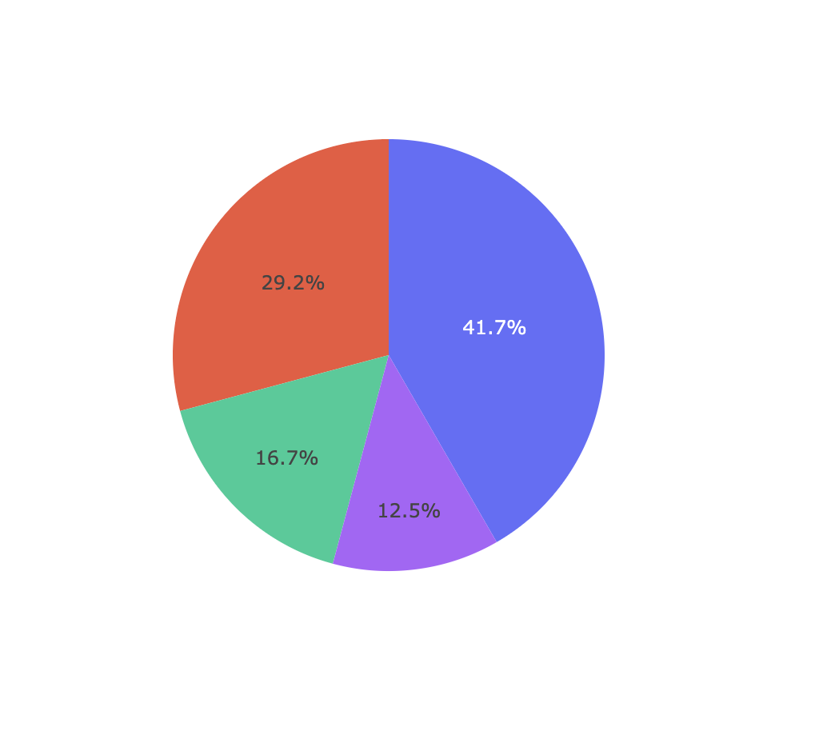

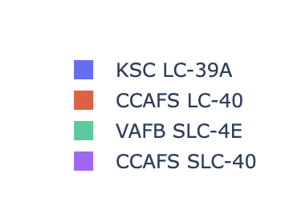
Launch Site Success Rate for All Sites
This chart examines successful landing outcomes and breaks them down by associated launch sites.
Kennedy Space Center Launch Complex 39A had the highest percentage of the successful launch outcomes, with 41.7% (10 of 24)
The lowest percentage of successful launch outcomes was attributed to Cape Canaveral Space Launch Center 40 with 12.5% (3 of 24)

Slide 38
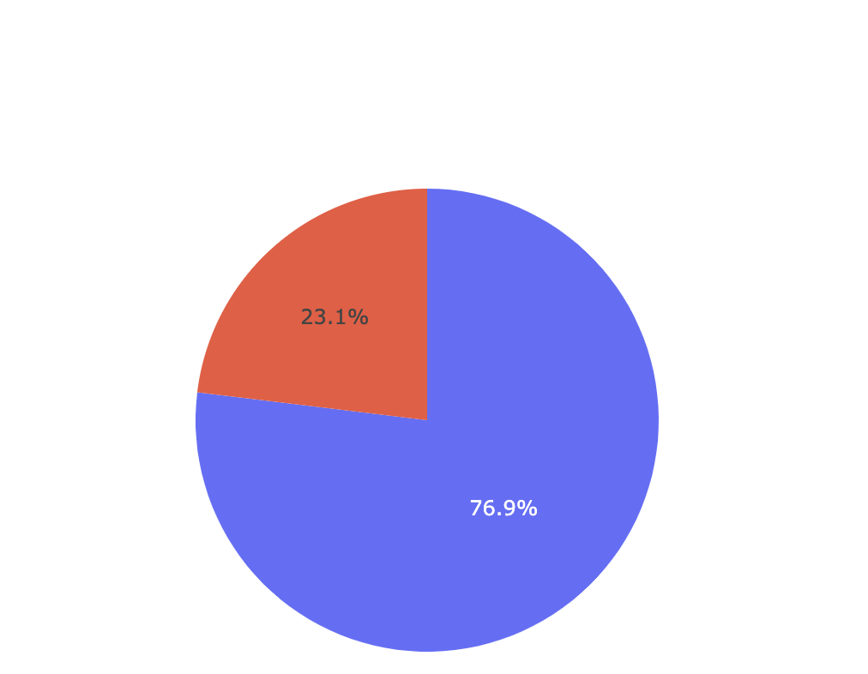

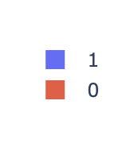
Launch Site with Highest Launch Success Ratio
This chart examines launches from Kennedy Space Center Launch Complex 39A and breaks down launch outcomes by Success and Failure.
The breakout of successful launch outcomes, was 76.9% (10 of 13)
This resulted in Kennedy Space Center Launch Complex 39A having the highest launch success ratio
Legend
Success
Failure

Slide 39
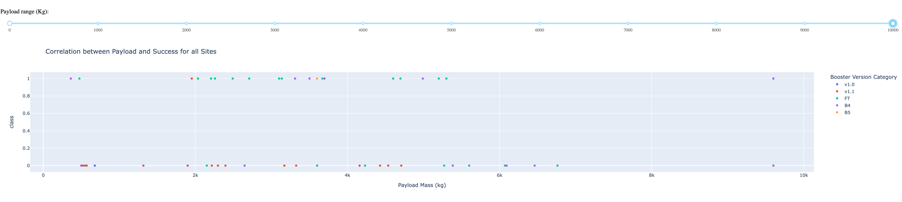
Payload vs. Launch Outcome – Overall Findings
This chart accounts for launches from all sites and payload ranges, with each launch labeled with a color-coded Booster Version Category. The x-axis shows the range of Payload Mass in kilograms (kg) and the y-axis shows launch outcomes, where Class of 1 indicates a successful launch outcome and Class of 0 indicates a failed launch outcome.
Most launches occur with Payload Mass ranging from 500 to 6000 kg
The majority of successful launch outcomes occur with Payload Mass ranging from 2000 to 6000 kg
The FT Booster Version Category had the most successful launch outcomes, followed by the B4
In this Payload Mass range (2000 – 6000 kg) the percentage of launch outcomes that were successful is 53% (17 of 32)

Slide 40
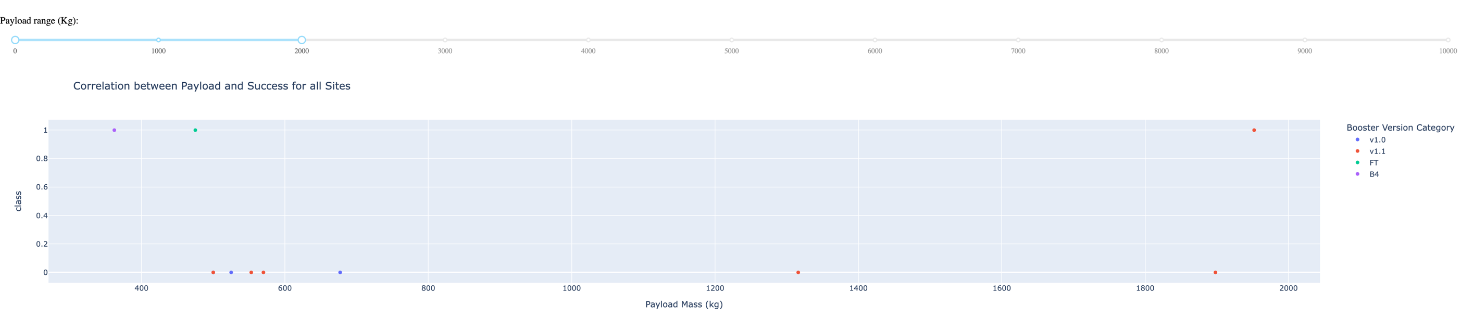
Payload vs. Launch Outcome - Lower Range of Payload Mass
This chart accounts for launches with Payload Mass less than 2000 kg.
There were ten launches with payloads less than 2000 kg
Three successful launches included Booster Version Categories of FT, B4 and v1.1
Seven failed launches included Booster Version Categories of v1.0 and v1.1
In this Payload Mass range the resulting percentage of launch outcomes that were successful is 30%

Slide 41
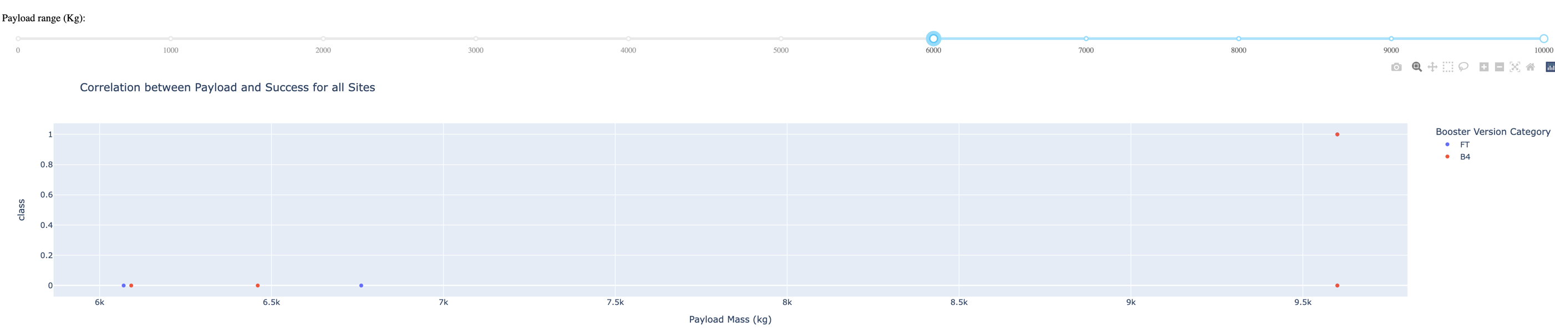
Payload vs. Launch Outcome - Higher Range of Payload Mass
This chart accounts for launches with Payload Mass greater than 6000 kg.
There were six launches with payloads greater than 6000 kg
There was one successful launch with a B4 Booster Version Category
The other five launches failed with Booster Version Categories of B4 and FT
In this Payload Mass range the resulting percentage of launch outcomes that were successful is 17%

Slide 42

Section 5

Slide 43
Classification Accuracy
The Decision Tree classification method had the best accuracy
Decision Tree F1 score of .836 versus a score of .815 for the other three methods

Slide 44
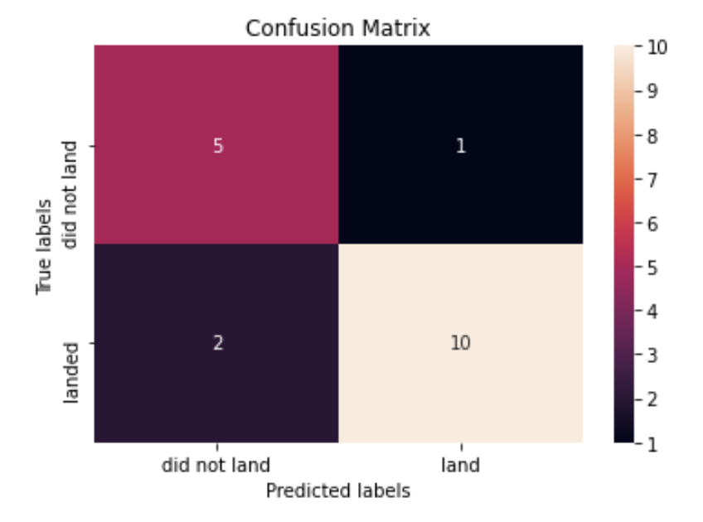
Confusion Matrix From the Decision Tree Model
The Decision Tree classification method correctly predicted 10 of the 12 ‘landed results’ (83.3%)
The method correctly predicted 5 of the 6 ‘did not land’ results (83.3%

Slide 45
Results - EDA and Predictive Analysis
Exploratory data analysis – identified relationships (main effects and interactions) with several variables to help develop the features data set for classification (e.g., Landing Outcomes and Success, Launch Site, Payload, Orbit, Booster Version, Landing Pad); in particular:
Orbits with highest launch success include Sun Synchronous Orbit (SSO), Highly Elliptical Orbit (HEO), Geosynchronous Orbit (GEO), and Earth Sun Lagrange Point (ES-L1), all at 100%
Launch success generally appears to improve over time between 2010-2020
Predictive analysis
Among the four models, Decision Tree distinguishes best between the different classes, with 83.3% prediction accuracy for ‘landed’ results and ‘did not land’ results
The other three models had identical prediction results (100% correct ‘landed’ results, 50% correct ‘did not land’ results)

Slide 46
Results – Visual Analytics
Folium visual analytics - launch sites are in close proximity to highways, rail lines and coastlines, but further in distance from cities
Plotly Dashboard visual analytics
Kennedy Space Center Launch Complex 39A had the highest number of successful launches of the four launch sites in study, as well as the highest percentage of launches with successful outcomes
Booster Version Category FT had the highest number of successful launches of the five Booster Version categories
The majority of successful launch outcomes occur payload mass ranging between 2000 and 6000 Kg

Slide 47
Conclusions
Use of Exploratory Data Analysis and Interactive Visual Analytics resulted in the identification of variables for the classification features data set – such as Launch Site, Payload Mass, Orbit, Booster Version, and Landing Pad
Among the four studied classification models, Decision Tree distinguished best between the different classes, with 83.3% prediction accuracy for ‘landed’ results and ‘did not land’ results
Given the presented launch data, yes, using EDA and Predictive Analysis, we can predict whether the Falcon 9 first stage will land successfully

Slide 48
Appendix
This appendix shows a few relevant assets created during this project (e.g., data sets)

Slide 49
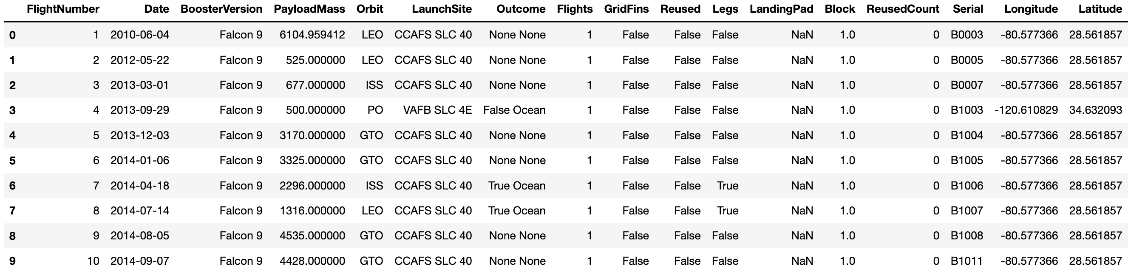
Appendix 1 – Initial Launch Data Set
Shows first 10 records of the initial launch data set prior to data wrangling

Slide 50
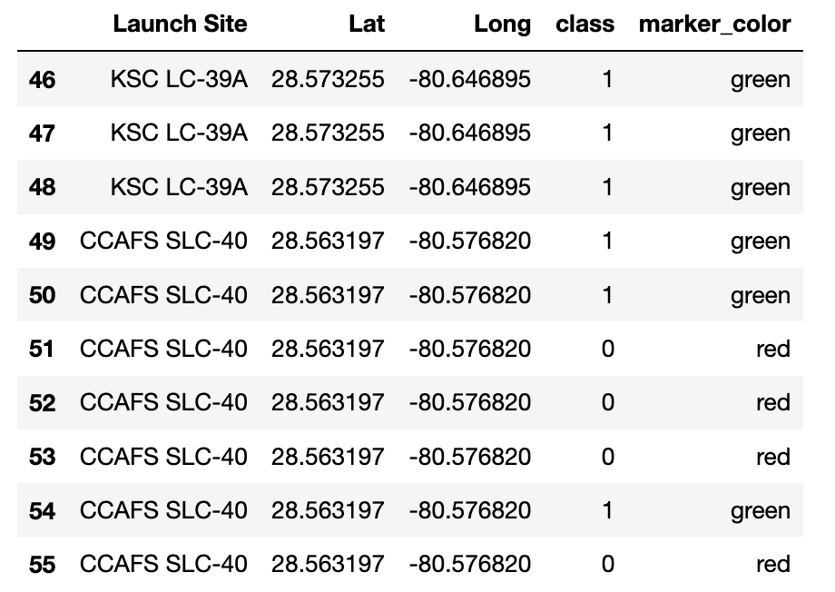
Appendix 2 – Launch Site Locations and Success Indicator
Shows Launch Site locations, success indicator and color marker for the Folium maps

Slide 51
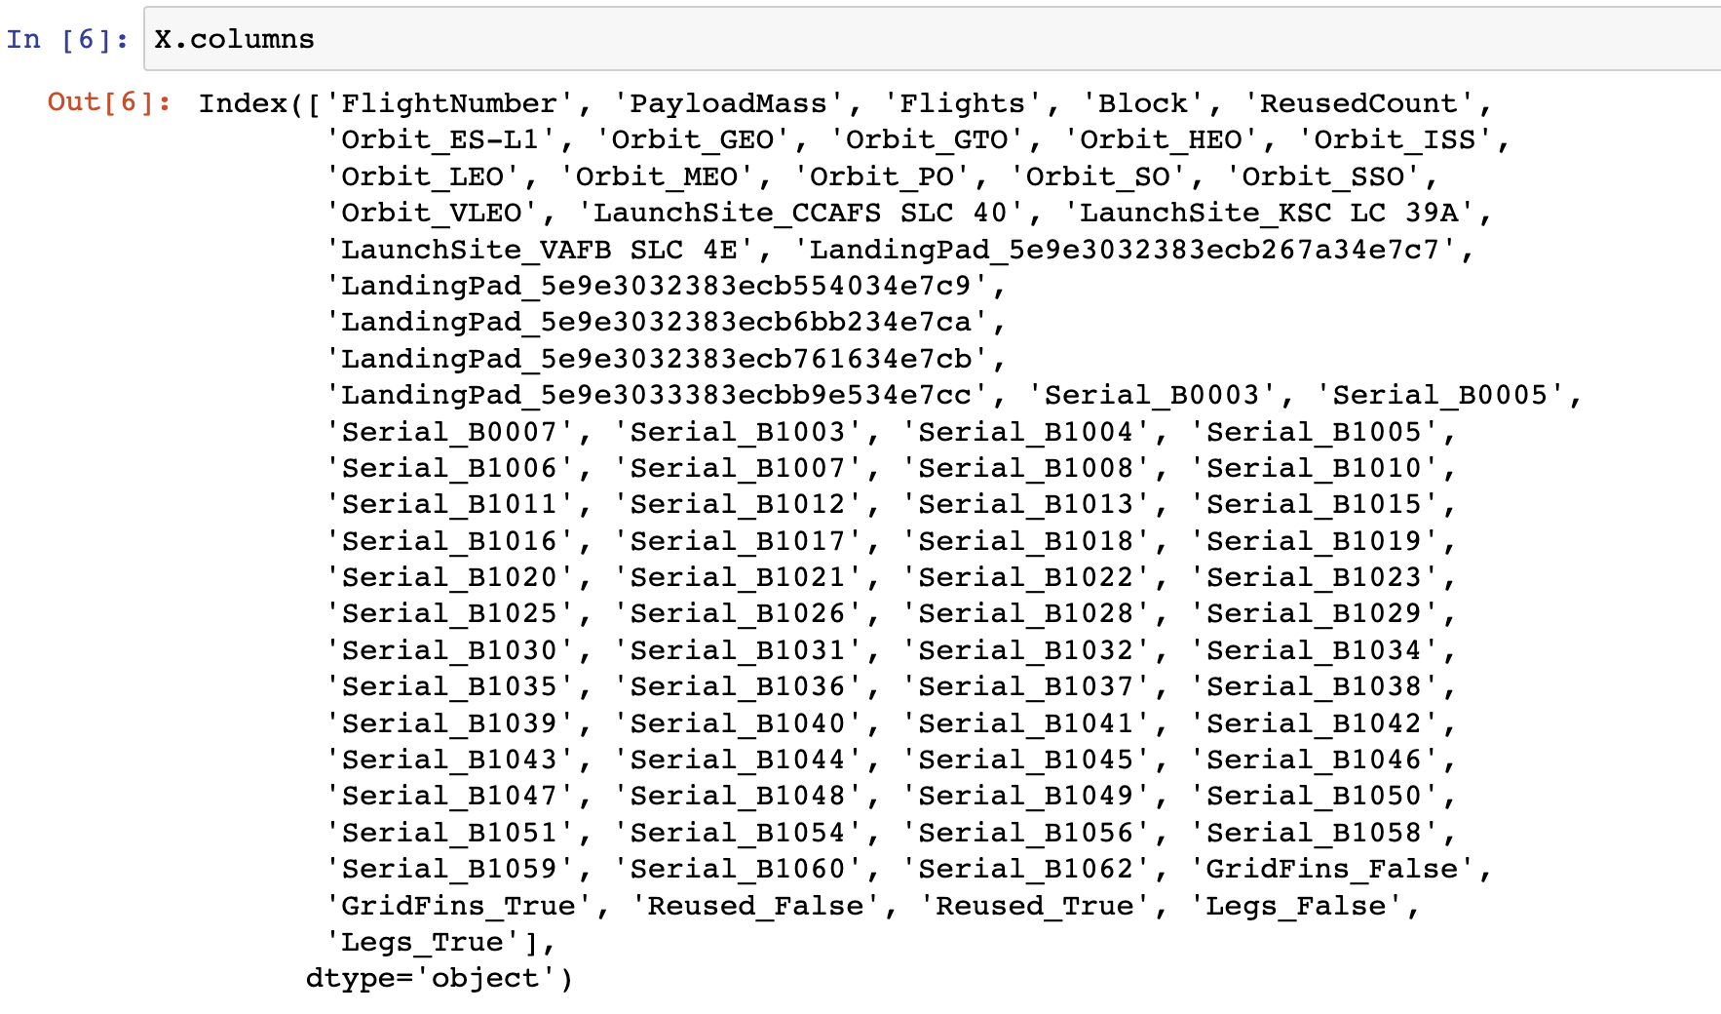
Appendix 3 – Classification – Features Data Set
Shows columns in the features data set for machine learning launch outcome prediction

Slide 52


